Slide 1
Managing IT Assets
Ray Trygstad
ITM 574 Section 071
Spring 2003
Master of Information Technology & Management Program
Center for Professional Development

Slide 2
Introduction
Today we will examine:
  IT asset management
  IT lifecycle
  Benefits of good IT asset management

Slide 3
Objectives
At the conclusion of this lesson, the student should be able to:
  Describe the necessity for IT asst management
  Recall and describe the asset management concerns in each stage of the IT lifecycle
  Explain the benefits of good IT asset management

Slide 4
IT Assets
All information technology assets of the enterprise
  Computers
    Mainframe / mid-range / personal
    Software and applications
  Peripherals
  Networking infrastructure
  Network attached devices
  Possibly communications and handheld devices

Slide 5
IT Asset Management
“The point at which finance and IT meet”
Three Legs of IT Asset Management
  The management and tracking of software and hardware assets
  The management of service-level agreements (SLAs), software licenses and other service contracts
  The accounting component, including the calculation and depreciation of taxes

Slide 6
Necessity for IT Asset Management
Determine return on investment in IT
Avoid unnecessary purchases
Reduce costs
  IDC reports IT firms with good asset management practices save 15% on IT staffing costs
Legal requirements
  Software license compliance
  Taxes

Slide 7
IT Asset Management is Financial
Asset management primarily a financial activity
Some theories say that due to this,
asset management system should
avoid tracking operational and other data about the asset
  Concentrate the financial aspects
Others see it as effective tool for both operational and financial use
  (I’m in this camp)

Slide 8
Tools for Asset Management
Billion dollar industry
Thousands of tools available
All computer based
  May be integrated with corporate asset management or standalone
May include tagging standards or systems, both physical and electronic

Slide 9
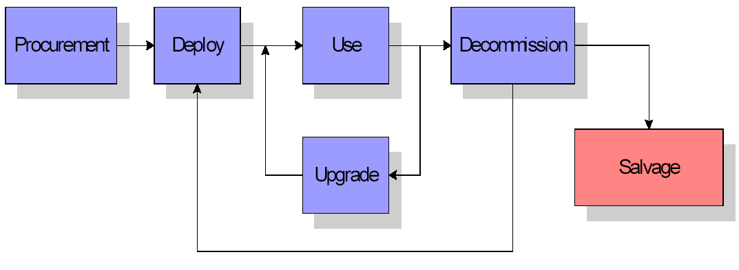
Asset Management Lifecycle
Consistent lifecycle model for IT Assets
Adapted from Windley, Phillip J, Managing IT Assets; Office of the Governor, State of Utah 2002

Slide 10
Procurement Phase
Asset enters the asset management system
  Upon Receipt
  Begins to be managed
Asset management system receives data
  All applicable information on the new asset
  Includes software licensing/SLA’s, etc.
Receiving organization acknowledges receipt
  Confirms the asset in the asset management system
  Authorizes release of payment

Slide 11
Deployment Phase
Asset management system updated
  location
  responsible party in the organization
  configuration
  vendor
  warranty
  any other data that will be useful in managing the asset

Slide 12
Deployment Phase
Location
  May be physical location
  May be link to other asset containing the asset being deployed
    i.e. software or memory may be tied to a physical system and would be located wherever that system is located
  Critical information for asset tracking

Slide 13
Usage Phase
Not simply static
Should be periodically updated by operational software that measures asset usage
  Ensures valuable assets not being used can be redeployed
Installed software must be tracked

Slide 14
Upgrade Phase
During product lifecyle, at least one upgrade cycle can be expected, i.e.
  Software version changed
  New hard drive added
  Additional memory added
Configuration information for asset must be updated accordingly

Slide 15
Decommissioning Phase
May still be useful in organization
  May be redeployed, i.e.
    Linux server
    File/print server
    Process control
Otherwise system should have some salvage value
  Asset management system should track until salvage completed or item is recycled

Slide 16
Benefits: Inventory Control
Important input into general ledger system for depreciation calculations
Helps prevent theft of organizational assets

Slide 17
Benefits: Total Cost of Ownership
TCO: A measure of all aspects of owning and operating an asset
System reduces TCO by:
  Eliminating costs from
    Duplication of assets
    Wasting of assets by not using them after purchase
  Reducing
    Effort required to track assets
    Risk of software license non-compliance
  Facilitating better asset operations
  Tracking warranty information
    Avoids paying for covered repairs

Slide 18
Benefits: Software License Compliance
Major task of any IT organization is tracking software licenses & ensuring proper allocation & use
Failure to comply = financial risk & legal liability
Becomes time sink as IT organization focuses compliance instead of adding value to the mission of the organization

Slide 19
Benefits: Operational Monitoring/Control
Many organizations administer systems using operational monitoring and control systems
Asset management systems can form the basis for the operational system
  Supply vital information to operational system when asset deployed or remove it when asset decommissioned

Slide 20
Benefits: Decision Support
Support decisions about IT resource deployment
  IT assets often deployed with little understanding of how they will be used
  In many cases not used as originally intended
    I.e. computer may be deployed and rarely used or may be deployed and overused.
When data from asset management system combined with operational data adverse usage patterns can be easily seen & resources reallocated to better add value

Slide 21
Benefits: Zero-day Employee Provisioning
New employees should have everything necessary to start work and be productive in place
Includes computer properly set-up & configured with right software, access to appropriate data, a phone, & other devices
When employees leave, equipment should move to decommissioning phase
  Available for redeployment

Slide 22
Benefits: Standardization and Compliance
Non-standard equipment/software cost money
Non-standard IT infrastructure requires more employees to manage
  Employees may less productive as they are less likely to be experts at managing non-standard assets
Time is wasted when people are required to use and understand non-conforming data and systems
System can tell an organization the level of compliance with standards

Slide 23
Benefits: More Informed Purchasing
When combined with operational data, asset management system can help in evaluation of past purchasing decisions
& assist in better future purchasing decisions
System can track vendors & provide data about how one vendor performs relative to another in key areas such as delivery, support, etc.

Slide 24
Benefits: Business Resumption Support
If assets lost through disaster or theft or damage, system can help business resume operations more quickly
By knowing what assets are in use and how they are configured, the system contains data vital to disaster recovery

Slide 25
Conclusion
Failure of asset management may result in
  Wasting time and resources managing inventory
  Purchasing unnecessary equipment and software
  Unnecessary effort in maintaining license compliance for software

Slide 26
Conclusion
With functional asset management, we can:
  Reduce the total cost of ownership for IT infrastructure
  Provide a solid foundation for operational systems necessary to keep infrastructure operating efficiently

Slide 27
The End…
Questions?
Discussion!

